Slide 1
Chapter 5: CPU Scheduling

Slide 2
Outline
Basic Concepts
Scheduling Criteria
Scheduling Algorithms
Thread Scheduling
Multiple-Processor Scheduling
Real-Time CPU Scheduling
Operating-Systems Examples
Algorithm Evaluation

Slide 3
Outline
Basic Concepts
CPU-I/O Burst Cycle
CPU Scheduler
Preemptive and Nonpreemptive Scheduling
Dispatcher
Scheduling Criteria
Scheduling Algorithms
Thread Scheduling
Multiple-Processor Scheduling
Real-Time CPU Scheduling
Operating-Systems Examples
Algorithm Evaluation

Slide 4
CPU-I/O Burst Cycle
Background
CPU–I/O Burst Cycle – process execution consists of a cycle of CPU execution and I/O wait
CPU burst, I/O burst, CPU burst, I/O burst……
CPU burst distribution – usually a large # of short CPU bursts and a small # of long CPU bursts
I/O bound: many short CPU bursts, few long I/O bursts
Spend more time doing I/O than computations
CPU-bound: have a few long CPU burst
Spend more time doing computations

Slide 5
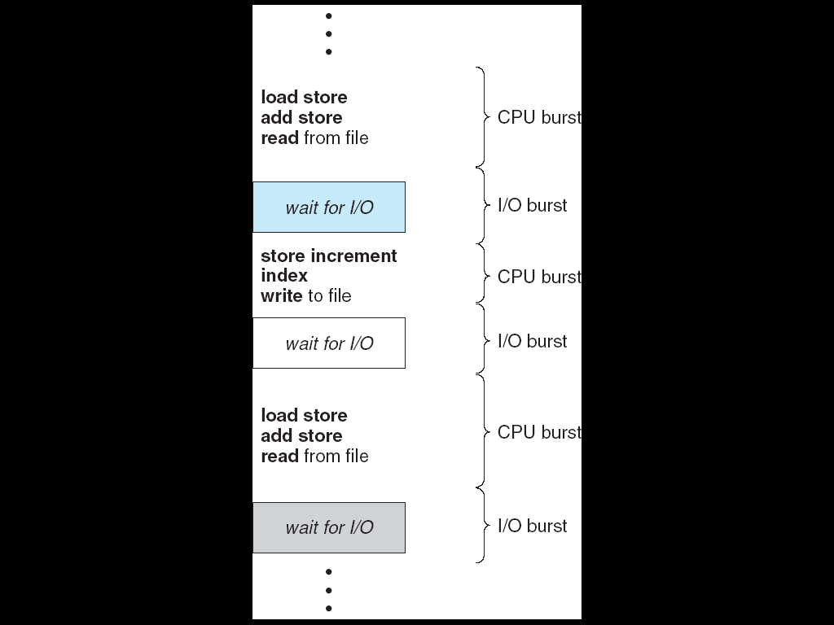
Alternating Sequence of CPU And I/O Bursts
…
a=a+1;
b=b-1;
c=cx5
fread()
x=x+1;
y=bx3;
fwrite()
b=ax1;
b=a-1;
c=dxa
fread()
…

Slide 6
Outline
Basic Concepts
CPU-I/O Burst Cycle
CPU Scheduler
Preemptive and Nonpreemptive Scheduling
Dispatcher
Scheduling Criteria
Scheduling Algorithms
Thread Scheduling
Multiple-Processor Scheduling
Real-Time CPU Scheduling
Operating-Systems Examples
Algorithm Evaluation

Slide 7
Process Scheduling
Term Definition
Process scheduler (or CUP scheduler)
Selects from among the processes that are ready to execute, i.e., in the ready queue
Degree of multiprogramming
The number of processes currently in memory

Slide 8
Outline
Basic Concepts
CPU-I/O Burst Cycle
CPU Scheduler
Preemptive and Nonpreemptive Scheduling
Dispatcher
Scheduling Criteria
Scheduling Algorithms
Thread Scheduling
Multiple-Processor Scheduling
Real-Time CPU Scheduling
Operating-Systems Examples
Algorithm Evaluation

Slide 9
Preemptive and Nonpreemptive Scheduling
CPU scheduling decisions may take place when a process:
1. Switches from running to waiting state
e.g. perform I/O or invoke wait()
2. Switches from running to ready state
e.g., when quantum expires
3. Switches from waiting to ready state
e.g., at completion of I/O
4. Terminates

Slide 10
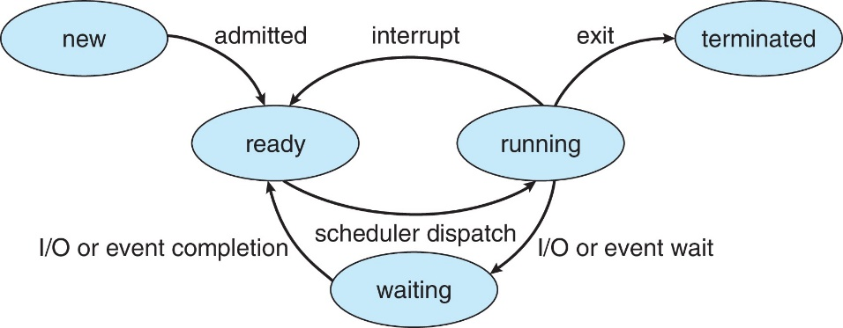
複習：Diagram of Process State

Slide 11
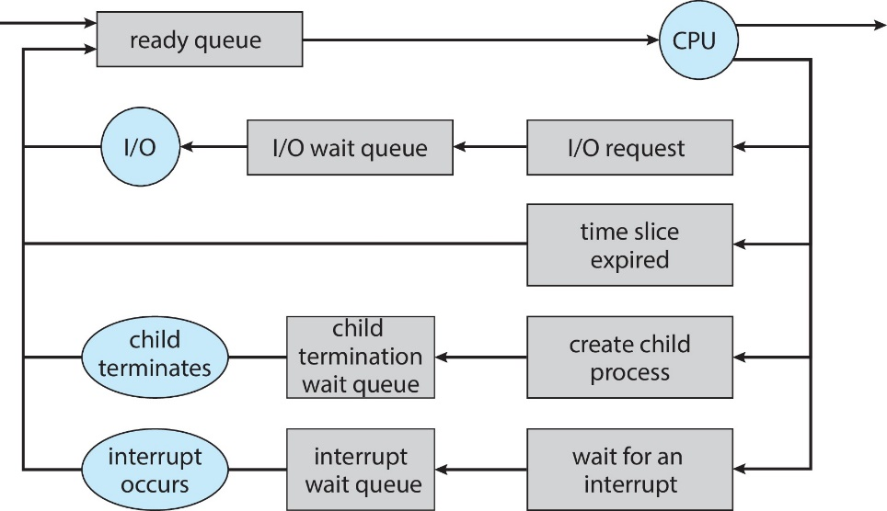
複習： Representation of Process Scheduling
CPU Scheduler
terminate
Free PCB
and
resources

Slide 12
Nonpreemptive v.s Preemptive
Nonpreemptive or cooperative scheduling
When scheduling takes place only under 1 and 4
Process keeps the CPU until it releases the CPU
Bad for time-sharing system
Preemptive scheduling
Scheduling takes place under all the circumstances (1 to 4)
A process having obtained CPU may be forced to release CPU
A cost associated with shared data access
A process may be preempted in an unsafe point, addressed in Chapter 6

Slide 13
Outline
Basic Concepts
CPU-I/O Burst Cycle
CPU Scheduler
Preemptive and Nonpreemptive Scheduling
Dispatcher
Scheduling Criteria
Scheduling Algorithms
Thread Scheduling
Multiple-Processor Scheduling
Real-Time CPU Scheduling
Operating-Systems Examples
Algorithm Evaluation

Slide 14
Dispatcher
Dispatcher: gives a CPU core to the process selected by the CPU scheduler
This involves:
Switching context from one process to another process
Switching to user mode
Jumping to the proper location in the user program to resume that program
Dispatch latency – time it takes for the dispatcher to stop one process and start another running
Should be as fast as possible

Slide 15
複習： Context Switch
…
out eax, 0x60;
add eax, ebx;
…
CPU
context
switch
eax | 59
ebx | 25
eax | 10
ebx | 5
…
out eax, 0x30;
add ebx, ebx;
…
…..
P1 PCB
eax=10; ebx=5;……
P1 PCB
eax=x; ebx=y;……
OS
P2 PCB
eax=59; ebx=25;……
OS

Slide 16
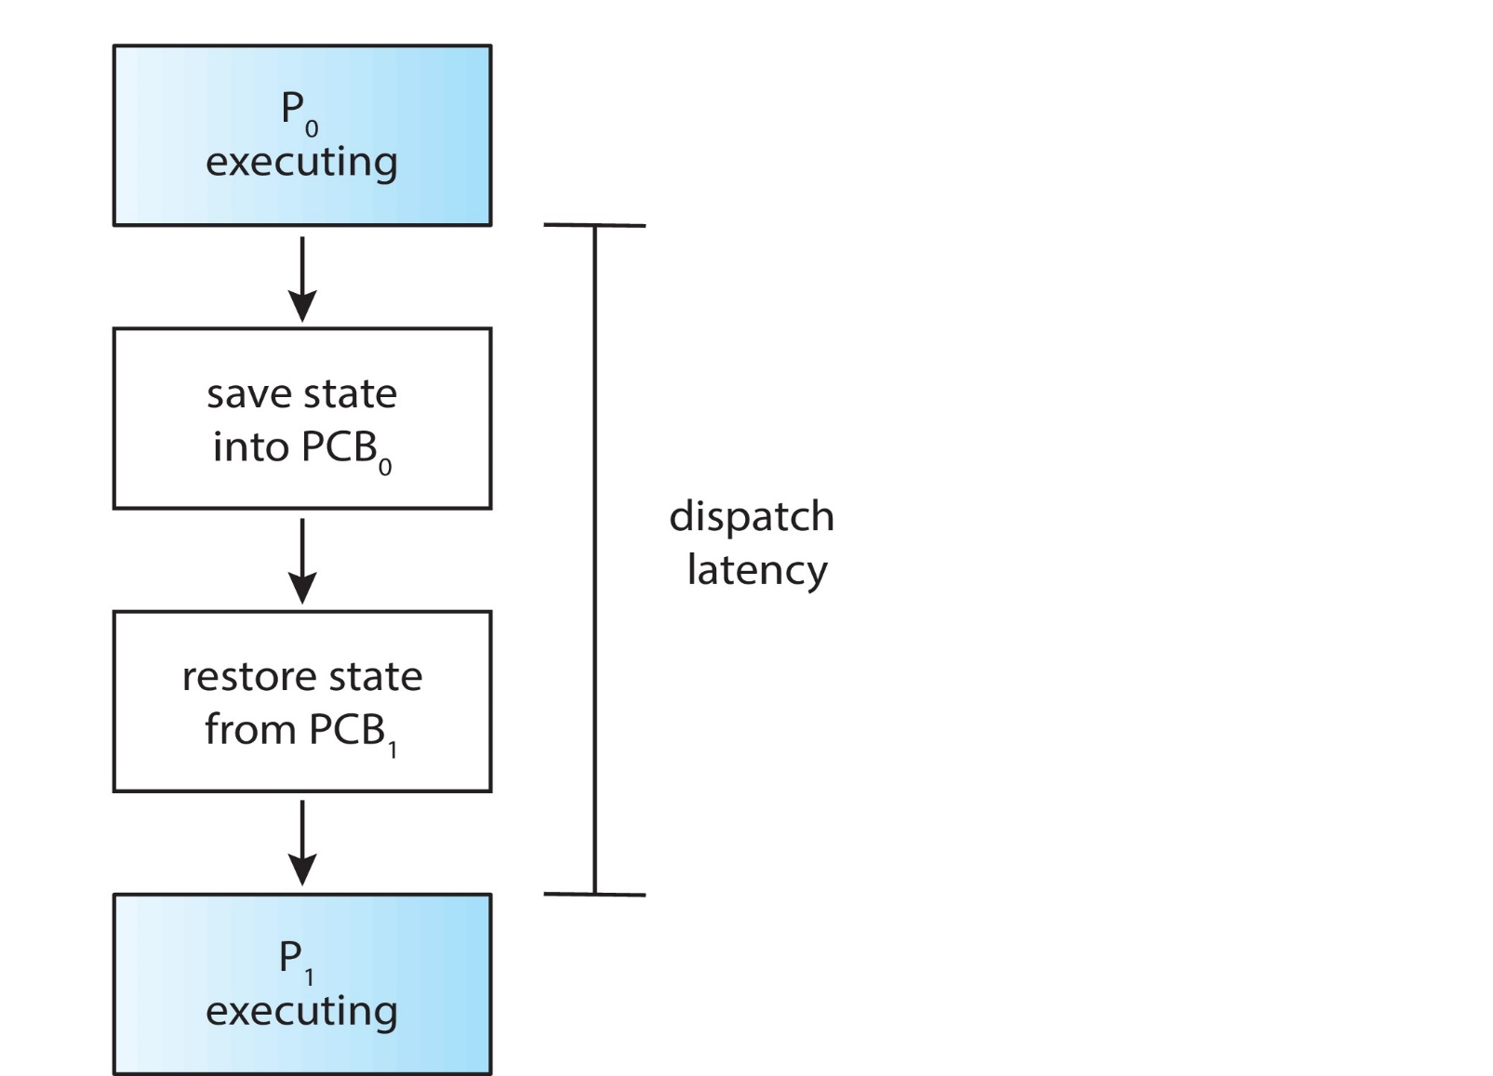
The Role of the Dispatcher

Slide 17
Outline
Basic Concepts
Scheduling Criteria
Scheduling Algorithms
Thread Scheduling
Multiple-Processor Scheduling
Real-Time CPU Scheduling
Operating Systems Examples
Algorithm Evaluation

Slide 18
Scheduling Criteria (準則)
Used to judge the performance of a scheduling algorithm
CPU utilization
Keep the CPU as busy as possible
Throughput
Number of processes that are completed per time unit
Turnaround time
Amount of time to execute a particular process
From process submission to process termination
Waiting time
Amount of time a process has been waiting in the ready queue
Response time
Amount of time it takes from when a request was submitted until the response is produced
For interactive processes, we may not care the turnaround time

Slide 19
Scheduling Criteria (Cont.)
Optimization Criteria -- may be conflict
Max CPU utilization
Max throughput
Min turnaround time
Min waiting time
Min response time

Slide 20
Outline
Basic Concepts
Scheduling Criteria
Scheduling Algorithms
First-Come, First-Served Scheduling
Shortest-Job-First Scheduling
Priority Scheduling
Round-Robin Scheduling
Multilevel Queue Scheduling
Multilevel Feedback-Queue Scheduling
Thread Scheduling
Multiple-Processor Scheduling
Real-Time CPU Scheduling
Operating Systems Examples
Algorithm Evaluation

Slide 21
First-Come, First-Served (FCFS) Scheduling
Ready queue is a FIFO queue
Example:
Process CPU Burst Time
P₁ 24
P₂ 3
P₃ 3
Suppose that the processes arrive in the order: P₁ , P₂ , P₃
The Gantt Chart for the schedule is:
Waiting time for P₁ = 0; P₂ = 24; P₃ = 27
Average waiting time: (0 + 24 + 27)/3 = 17
P₁
P₂
P₃
0
24
27
30

Slide 22
First-Come, First-Served (FCFS) Scheduling (Cont.)
Suppose that processes arrive in the order: P₂ , P₃ , P₁
The Gantt chart for the schedule is:
Waiting time for P₁ = 6; P₂ = 0; P₃ = 3
Average waiting time: (6 + 0 + 3)/3 = 3
Much better than previous case
FCFS scheduling is nonpreemptive
Unsuitable for time-sharing systems
P₂
P₃
P₁
0
3
6
30

Slide 23
First-Come, First-Served (FCFS) Scheduling (Cont.)
Convoy effect (護衛）: many short processes wait for the one big process to get off the CPU
Consider one CPU-bound and many I/O-bound processes
問題：
CPU-bound為什麼是big process?
I/O-bound為什麼是short process?
Result in bad response time

Slide 24
Outline
Basic Concepts
Scheduling Criteria
Scheduling Algorithms
First-Come, First-Served Scheduling
Shortest-Job-First Scheduling
Priority Scheduling
Round-Robin Scheduling
Multilevel Queue Scheduling
Multilevel Feedback-Queue Scheduling
Thread Scheduling
Multiple-Processor Scheduling
Real-Time CPU Scheduling
Operating Systems Examples
Algorithm Evaluation

Slide 25
Shortest-Job-First (SJF) Scheduling
The smallest next CPU burst length is selected
FCFS breaks a tie if the next CPU burst lengths are the same
Should be named as: shortest-next-CPU-burst first algorithm
Depend on the length of next CPU burst of a process, not total length
Two schemes:
nonpreemptive –
preemptive – if a new process arrives with CPU burst length less than remaining time of current executing process, preempt the current process.
Also called the Shortest-Remaining-Time-First (SRTF) algoriothm

Slide 26
複習：Alternating Sequence of CPU And I/O Bursts
…
a=a+1;
b=b-1;
c=cx5
fread()
t
x=x+1;
y=bx3;
next CPU burst length
fwrite()
b=ax1;
b=a-1;
c=dxa
fread()
…

Slide 27
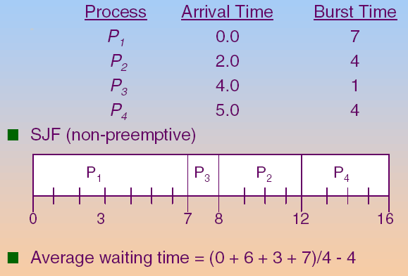
Example of Non-Preemptive SJF

Slide 28
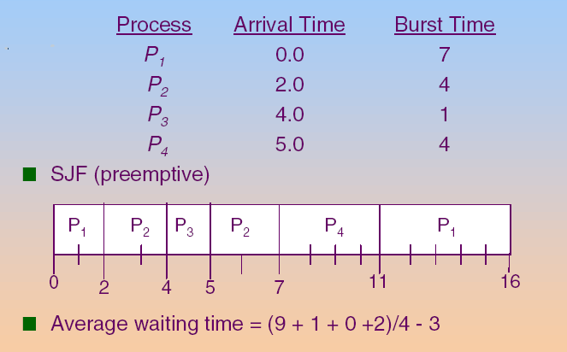
Example of Preemptive SJF

Slide 29
Shortest-Job-First (SJF) Scheduling (Cont.)
SJF is optimal – derives minimum average waiting time for a given set of processes
Problem: how to implement ?
Not easy to know the length of the next CPU burst
Sol.: predict

Slide 30

Predicting Length of Next CPU Burst
Predict method
Using the length of previous CPU bursts, using exponential averaging
$$τ_{n+1}=αt_{n}+(1−α)τ_{n}$$

Slide 31



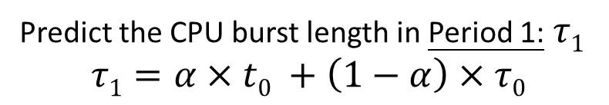




Example
Assume$α=0.8$, $τ0=0.01$
Period 0
Period 1
Period 2
Period 3
T
Predictive :
$$0.01$$
$$0.042$$
$τ$_{n}
Actual :
$$0.05$$
t_{n}
If actual CPU burst length in Period 0 $t_{0}$ = 0.05
Predict the CPU burst length in Period 1:$τ1$
$$τ1=α×t0 +\left(1−α\right)×τ0$$
$$α=0.8$$
$$τ0=0.01$$
$$=0.8×0.05+0.2×0.01=0.042$$
Notes:
我們將每100個c to dirty page做為一個區間
使用exponatio avg指數移動平均來預測下一區間的clean to dirty 的平均發生時間
那這個方法就是對於月靠近現在的值加權較多
舉例來說就是第一個區間的c to dirty平均發生間隔為t1
第二個是t2第三個是t3
而那麼我們預測第四個區間的c->d間隔是t3加權0.8，t2加權0.16，t1加權0.032,
離現在時間越遠的加權越少，這樣來平均，結果就會作為我們預測的t4
假設在這個時間點發生了定量flush,
我們預測下次定量flush的時間點為現在加上1024乘上t4

Slide 32







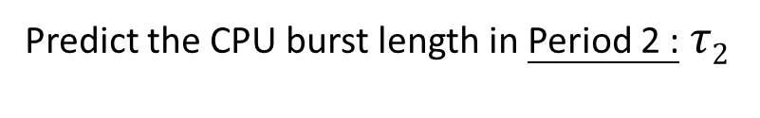




Example (Cont.)
Assume$α=0.8$, $τ0=0.01$
Period 0
Period 1
Period 2
Period 3
T
Predictive :
$$0.01$$
$$0.042$$
$$0.0564$$
$$0.0273$$
$τ$_{n}
Actual :
$$0.05$$
$$0.06$$
t_{n}
$$0.02$$
If actual CPU burst length in Period 1 $t_{1}$ = 0.06
Predict the CPU burst length in Period 2 :$τ2$
$$τ2=α×t1+\left(1−α\right)×τ1$$
$$=0.8×0.06+0.2×0.042=0.0564$$
If actual CPU burst length in Period 1 $t_{1}$ = 0.02
$$τ3=0.8×0.02+0.2×0.564=0.0273$$
Notes:
我們將每100個c to dirty page做為一個區間
使用exponatio avg指數移動平均來預測下一區間的clean to dirty 的平均發生時間
那這個方法就是對於月靠近現在的值加權較多
舉例來說就是第一個區間的c to dirty平均發生間隔為t1
第二個是t2第三個是t3
而那麼我們預測第四個區間的c->d間隔是t3加權0.8，t2加權0.16，t1加權0.032,
離現在時間越遠的加權越少，這樣來平均，結果就會作為我們預測的t4
假設在這個時間點發生了定量flush,
我們預測下次定量flush的時間點為現在加上1024乘上t4

Slide 33
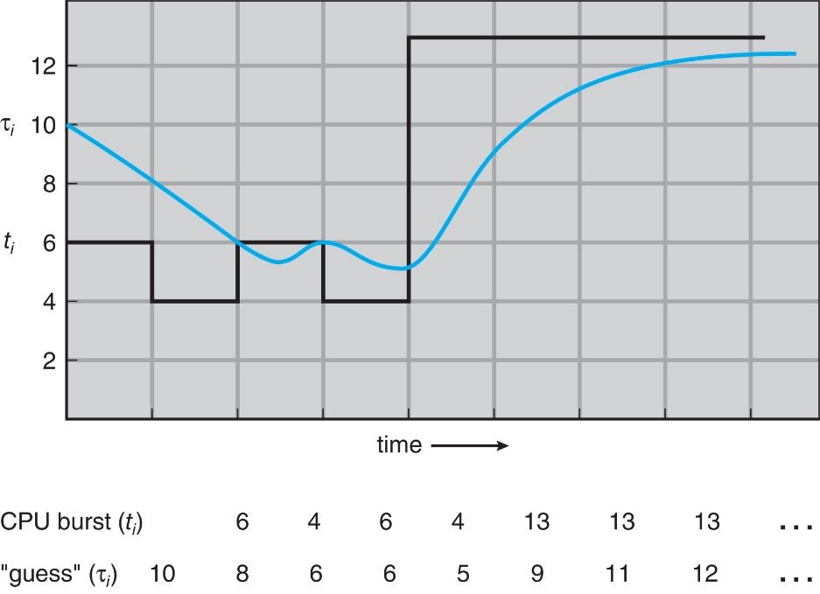
Prediction of the Length of the Next CPU Burst
τ₀ = 10
τ₁₌ α x 6 + (1- α) x 10 = 3 + 5 = 8
τ₂= α x 4+ (1- α) x 8 = 2 + 4 = 6
……

Slide 34
Examples of Exponential Averaging
α =0
τ_{n+1} = τ_{n}
Recent history does not count
α =1
τ_{n+1} = α t_{n}
Only the actual last CPU burst counts
If we expand the formula, we get:
τ_{n+1} = α t_{n}+(1 - α)α t_{n} ₋₁ + … +(1 - α )^{j} α t_{n} _{-j} + …+(1 - α )^{n +1} τ₀
Since both α and (1 - α) are less than or equal to 1,
Each successive term has less weight than its predecessor

Slide 35
Outline
Basic Concepts
Scheduling Criteria
Scheduling Algorithms
First-Come, First-Served Scheduling
Shortest-Job-First Scheduling
Round-Robin Scheduling
Priority Scheduling
Multilevel Queue Scheduling
Multilevel Feedback-Queue Scheduling
Thread Scheduling
Multiple-Processor Scheduling
Real-Time CPU Scheduling
Operating Systems Examples
Algorithm Evaluation

Slide 36
Round Robin (RR)
Each process gets a small unit of CPU time
Called time quantum or time slice
Usually 10-100 milliseconds.
After this time has elapsed, the process is preempted and added to the tail of the ready queue
RR is preemptive
FCFS is non-preemptive
Question:
How the OS knows a time quantum is expired?
Timer is set to the time slice value

Slide 37
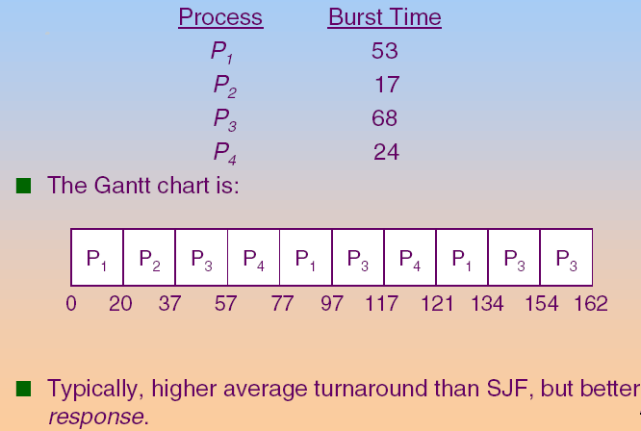
Example: RR with Time Quantum = 20

Slide 38
Round Robin (RR) (Cont.)
If there are n processes and the time quantum is q,
Each process gets 1/n of the CPU time in chunks of at most q time units at once.
No process waits more than (n-1)q time units.
Typically, higher average turnaround time than SJF, but better response
Performance
q large ⇒ FCFS
q small ⇒ q must be large enough so as to reduce the context switch overhead (see the following slide)
Rule of thumb: 80% of CPU bursts should be shorter than the time quantum (see the following slide)

Slide 39
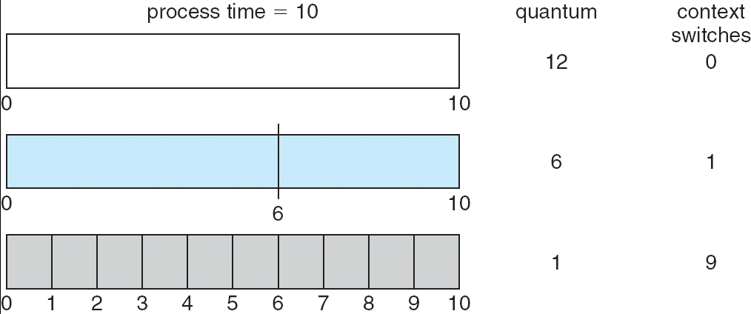
How a Smaller Time Quantum Increases Context Switches
Smaller time quantum, larger number of context switches
And context switches are not free!!!

Slide 40
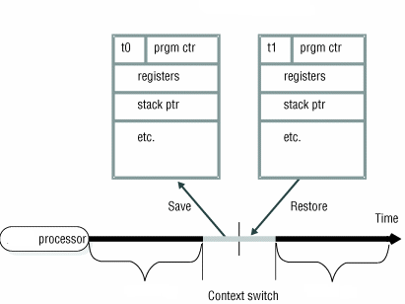
複習：Context Switch
P0’s PCB
P1’s PCB
process P0
process P1

Slide 41
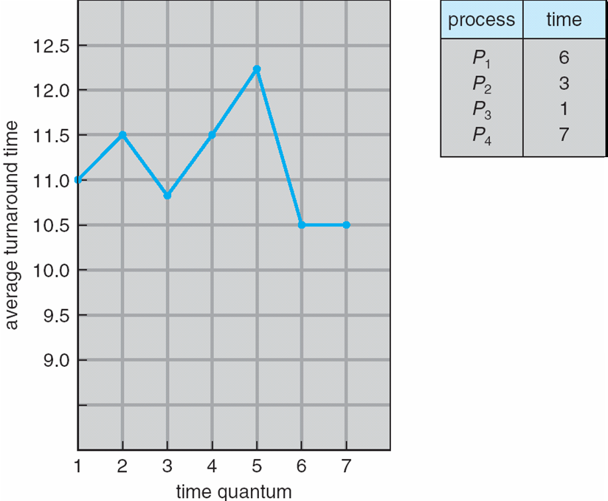
Turnaround Time Varies With The Time Quantum
CPU Burst Time
80% of CPU bursts should be shorter than q
q = 0.5 ⇨ 0%
q = 2 ⇨ 1/4=25%
q = 4 ⇨ 2/4=50%
q = 6 ⇨ 3/4=75%
…
Given four processes: p₁=6, p₂=3, p₃=1, p₄=7
=>The average turnaround time under different value of time quantum

Slide 42
Outline
Basic Concepts
Scheduling Criteria
Scheduling Algorithms
First-Come, First-Served Scheduling
Shortest-Job-First Scheduling
Round-Robin Scheduling
Priority Scheduling
Multilevel Queue Scheduling
Multilevel Feedback-Queue Scheduling
Thread Scheduling
Multiple-Processor Scheduling
Real-Time CPU Scheduling
Operating Systems Examples
Algorithm Evaluation

Slide 43
Priority Scheduling
A priority number (integer) is associated with each process
The CPU is allocated to the process with the highest priority
Preemptive
nonpreemptive
Problem: starvation or indefinite blocking
Low priority processes may never execute
At MIT, there was a job submitted in 1967 that had not been run when the system IBM 7094 was shutdown in 1973
Solution : aging
As time progresses increase the priority of the process

Slide 44
Example of Priority Scheduling
Process | Burst Time | Priority
P1 | 10 | 3
P2 | 1 | 1
P3 | 2 | 4
P4 | 1 | 5
P5 | 5 | 2
P₂
P₅
P₁
P₃
P₄
0
1
6
16
18
19
Assume smallest integer ≡ highest priority Average Waiting Time = 8.2

Slide 45
Outline
Basic Concepts
Scheduling Criteria
Scheduling Algorithms
First-Come, First-Served Scheduling
Shortest-Job-First Scheduling
Round-Robin Scheduling
Priority Scheduling
Multilevel Queue Scheduling
Multilevel Feedback-Queue Scheduling
Thread Scheduling
Multiple-Processor Scheduling
Real-Time CPU Scheduling
Operating Systems Examples
Algorithm Evaluation

Slide 46
Multilevel Queue Scheduling
Questions: if two or more processes have the same priority?
Sol.: combine RR with priority scheduling
Run the process with the highest priority.
Processes with the same priority use round-robin

Slide 47
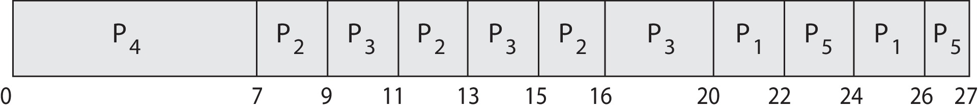
Priority Scheduling with Round-Robin
ProcessA arri Burst TimeT Priority
P₁ 4 3
P₂ 5 2
P₃ 8 2
P₄ 7 1
P₅ 3 3
Gantt Chart wit 2 ms time quantum

Slide 48
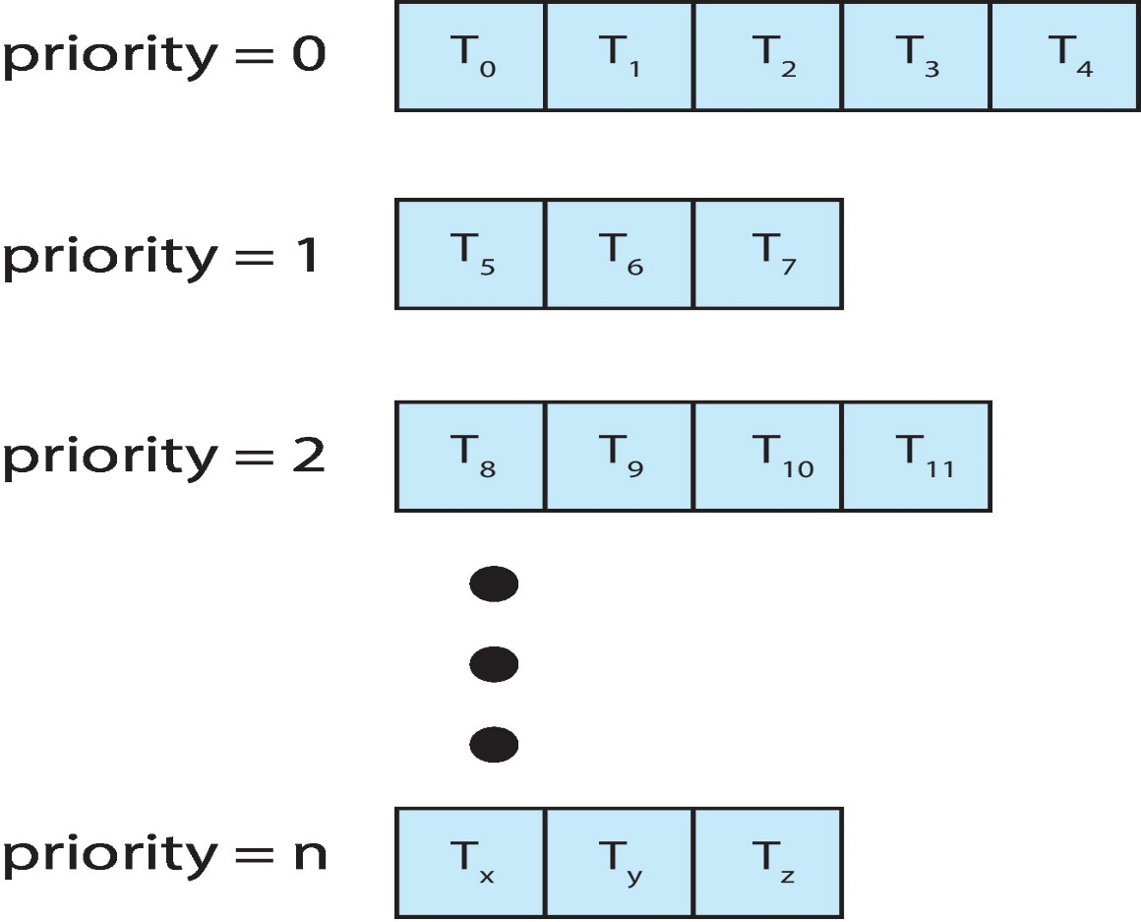
Multilevel Queue Scheduling (Cont.)
Question: How about the data structure?
If a single queue, O(n) search is necessary each time
Sol.: Multilevel queue is used instead

Slide 49
Multilevel Queue Scheduling
Multilevel queue scheduling can also be used when processes are classified into different types
E.g., foreground (interactive) and background (batch)
higher priority
foreground (interactive): RR
background (batch): FCFS
Example: A Two-Level Queue Scheduling

Slide 50
In this example, why RR is used for foreground processes and FCFS is used for background processes?

Slide 51
Multilevel Queue Scheduling
Ready queue is partitioned into separate queues:
According to process properties and scheduling needs
Processes are permanently assigned to one queue
Each queue has its own scheduling algorithm

Slide 52
Multilevel Queue Scheduling (Cont.)
Scheduling must be done between the queues
Fixed priority preemptive scheduling:
Foreground queue have absolute priority over background queue
Only when foreground queue is empty, then background queue is executed
Starvation problem
Time-slice based
Each queue gets a certain amount of CPU time
Example:
80% to foreground for RR
20% to background for FCFS

Slide 53
Outline
Basic Concepts
Scheduling Criteria
Scheduling Algorithms
First-Come, First-Served Scheduling
Shortest-Job-First Scheduling
Priority Scheduling
Round-Robin Scheduling
Multilevel Queue Scheduling
Multilevel Feedback-Queue Scheduling
Thread Scheduling
Multiple-Processor Scheduling
Real-Time CPU Scheduling
Operating Systems Examples
Algorithm Evaluation

Slide 54
Multilevel Feedback Queue
A process can move between the various queues
Example: separate processes according to the characteristics of CPU bursts
See the following slide

Slide 55
Example of Multilevel Feedback Queue
Three queues:
Q₀ – RR with time quantum 8 milliseconds
Q₁ – RR time quantum 16 milliseconds
Q₂ – FCFS
Scheduling
A new job enters queue Q₀ which is served RR.
When it gains CPU, job receives 8 milliseconds.
If it does not finish in 8 milliseconds, job is moved to tail of queue Q₁.
If Q₀ is empty, Q₁ is served by RR and receives 16 additional milliseconds.
If it still does not complete, it is preempted and moved to queue Q₂.

Slide 56
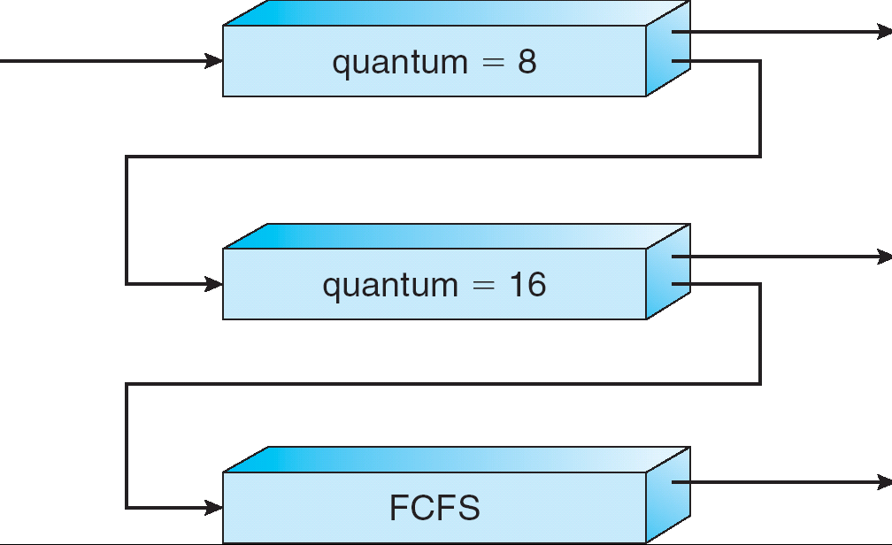
Multilevel Feedback Queues
Give highest priority to processes with CPU burst <= 8ms

Slide 57
Multilevel Feedback Queue
From above example:
A process uses too much CPU time => move to a lower priority queue
Thus, leave I/O-bound and interactive processes in the higher priority queues
Wait too long in a low priority Q ⇨ move to a higher priority queue
Aging

Slide 58
Multilevel Feedback Queues (Cont.)
Multilevel-feedback-queue scheduler defined by the following parameters:
Number of queues
Scheduling algorithms for each queue
Scheduling algorithms between the queues
When to upgrade a process
When to demote a process
Which queue a process will enter when that process needs service
It is the most generic algorithm
Can be configured to match a specific system
It is the most complex algorithm
Have to select a proper value for each parameter

Slide 59
Outline
Basic Concepts
Scheduling Criteria
Scheduling Algorithms
Thread Scheduling
Multiple-Processor Scheduling
Real-Time CPU Scheduling
Operating Systems Examples
Algorithm Evaluation

Slide 60
Contention Scope
User threads are managed and scheduled by thread library
Kernel threads are managed and scheduled by OS
Process-contention scope (PCS)
For M:1 or M:M models
Threads library schedules user thread to put onto an available kernel thread
Competitions among threads of the same process
But, when select a user thread onto a kernel thread
Do not mean that the thread is actually running on a CPU
System-contention scope (SCS)
Kernel decides which kernel thread to run on a CPU core
Competitions among all kernel threads in the system
Systems with 1:1 model only use SCS

Slide 61
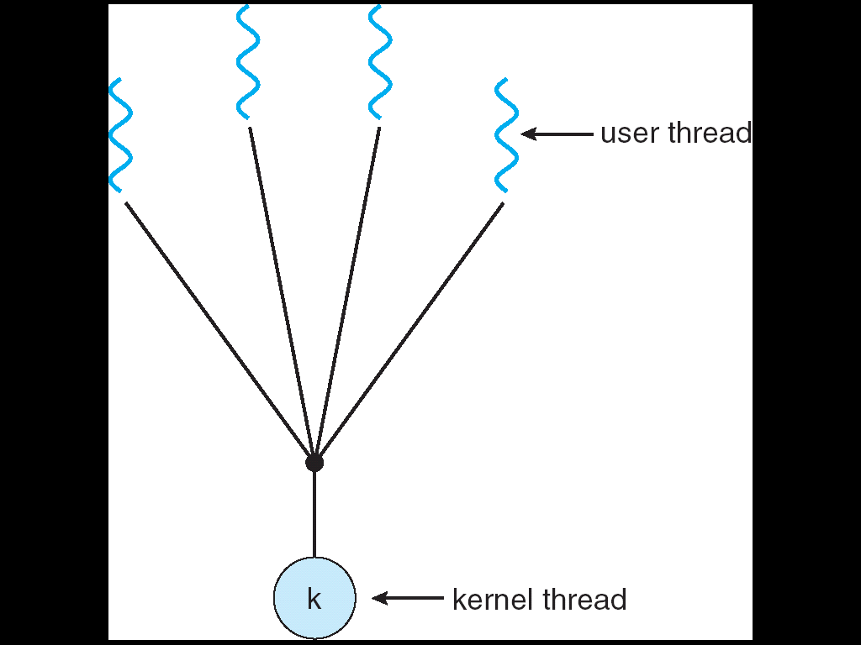
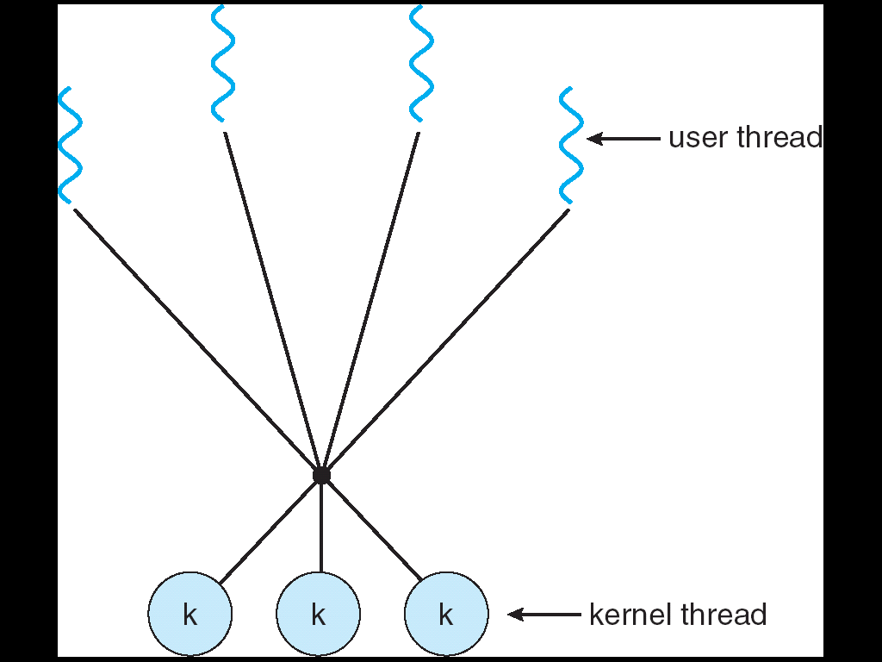
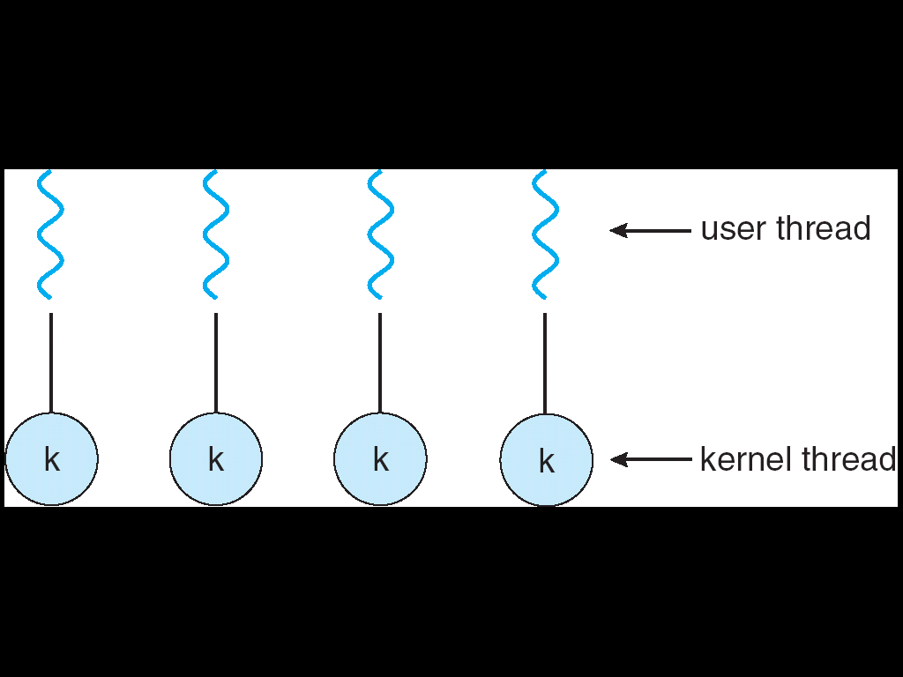
複習：Thread Models

Slide 62
Outline
Basic Concepts
Scheduling Criteria
Scheduling Algorithms
Thread Scheduling
Multiple-Processor Scheduling
Real-Time CPU Scheduling
Operating Systems Examples
Algorithm Evaluation

Slide 63
Multiple-Processor Scheduling
CPU scheduling more complex when multiple CPUs are available
Multi-processor may be any one of the following architectures:
Multicore CPUs
Multithreaded cores
NUMA systems
Heterogeneous multiprocessing
homogeneous

Slide 64
Outline
Basic Concepts
Scheduling Criteria
Scheduling Algorithms
Thread Scheduling
Multiple-Processor Scheduling
Approaches to Multiple-Processor Scheduling
Multicore Processors
Load Balancing
Processor Affinity
Heterogeneous Multiprocessing
Real-Time CPU Scheduling
Operating Systems Examples
Algorithm Evaluation

Slide 65
Approaches to Multiple-Processor Scheduling
Asymmetric multiprocessing
Only the master processor handle the scheduling algorithm
Advantage: simple
Disadvantage: master becomes the bottleneck
Symmetric Multiprocessing (SMP)
Each processor makes its own scheduling decisions
Standard approach, adopted by Windows, Linux, Mac OS
We focus on SMP systems

Slide 66
Approaches to Multiple-Processor Scheduling (Cont.)
Organizations of the ready queue in SMP
A common ready queue, or
Require some form of locking to protect the queue (addressed later)
Accessing the queue is a performance bottleneck
Each processor has its private ready queue
Good
Does not suffer from the protection overhead
Allow more efficient use of cache memory (addressed later)
Bad
Workload of varying size ⇨ solved by load balance (addressed later)
Most commonly used

Slide 67
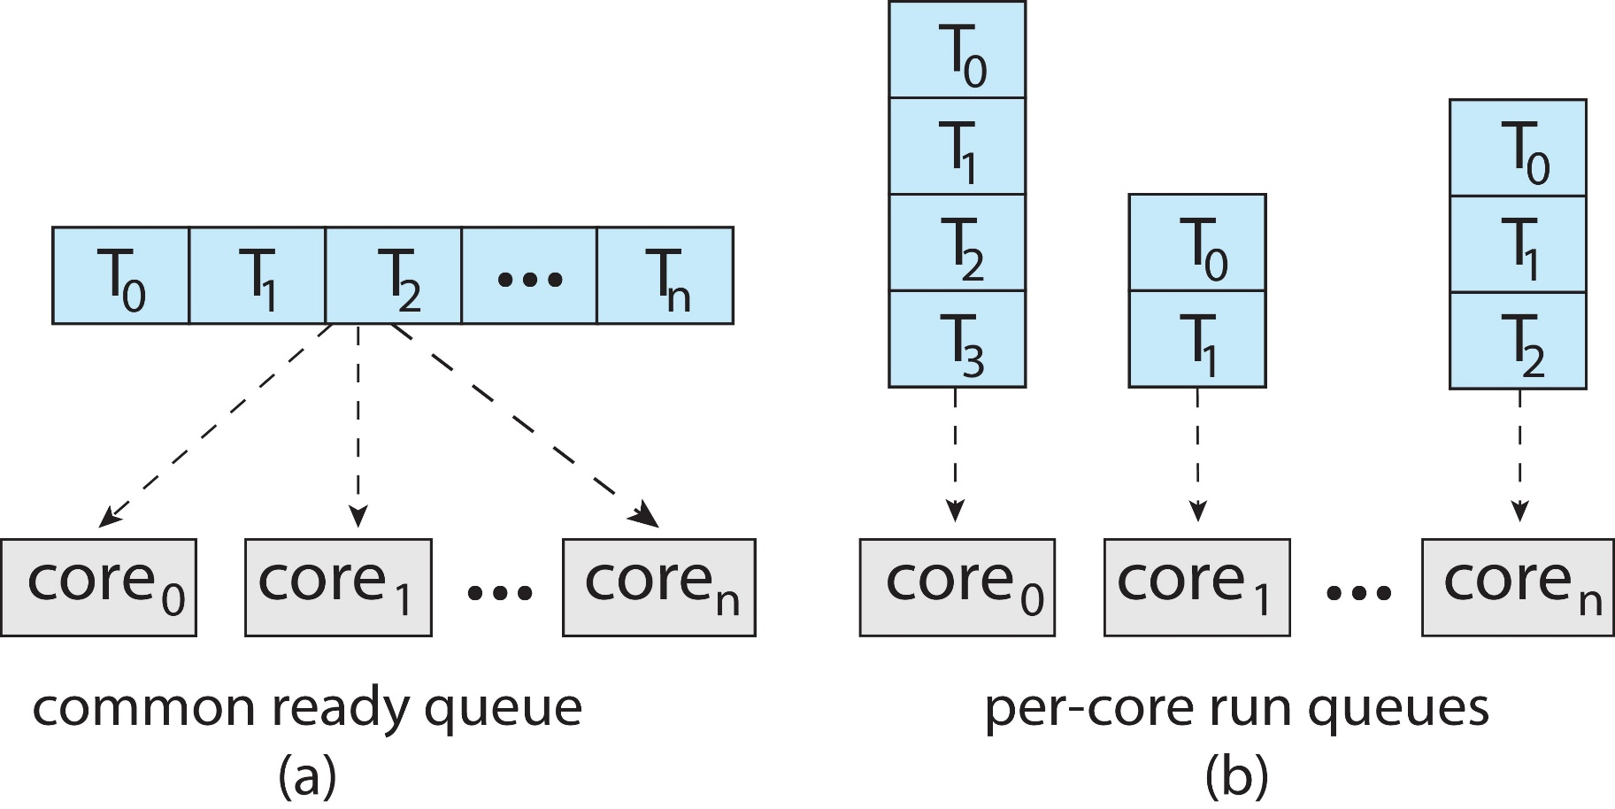
Organizations of Ready Queue in SMP

Slide 68
Outline
Basic Concepts
Scheduling Criteria
Scheduling Algorithms
Thread Scheduling
Multiple-Processor Scheduling
Approaches to Multiple-Processor Scheduling
Multicore Processors
Load Balancing
Processor Affinity
Heterogeneous Multiprocessing
Real-Time CPU Scheduling
Operating Systems Examples
Algorithm Evaluation

Slide 69
Multicore Processors
Multicore processor: multiple processor cores on the same chip
Problem: memory stall (使動彈不得)
Wait for data to become available (see the slide following the next one)
Solution: Chip-multithreading (CMT)
Two or more hardware threads in a core
If one hardware thread stalls, the core switches to another hardware thread
Similar to the multiprogramming concept in Chapter 1
Each hardware thread appear as a logical processor to OS
Each hardware thread has its own program counter and register set
Hyper-threading (also known as simultaneously multithreading or SMT) technology on Intel processor

Slide 70
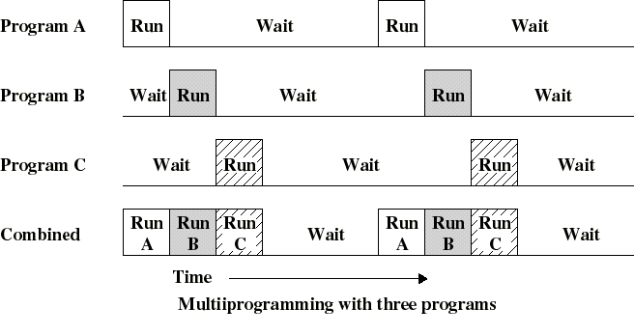
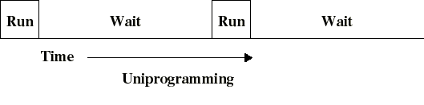
複習: Uni- vs. Multi-Programming
Context Switch is performed by OS

Slide 71
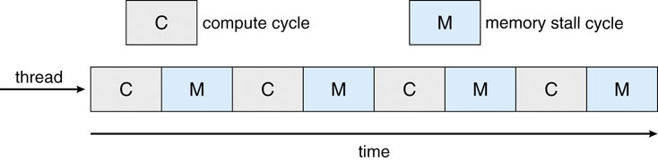
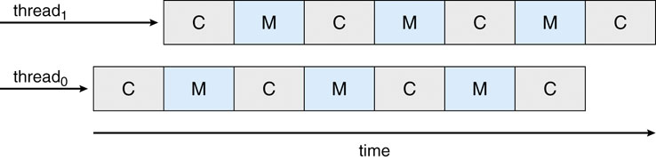
memory stall problem
Context Switch is performed by CPU
Multithreaded system: the two hardware threads share the same CPU core
-in fact, only one hardware thread is running at a time

Slide 72
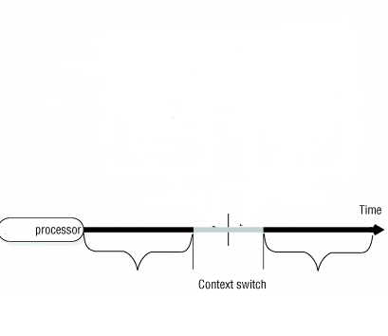
複習：Multiple Sets of Registers
CPU
eax₁=1;
ebx₁=5;
ecx₁=8;
edx₁=6;
……
eax₂=4;
ebx₂=3;
ecx₂=7;
edx₂=8;
……
……
process P1
process P2

Slide 73
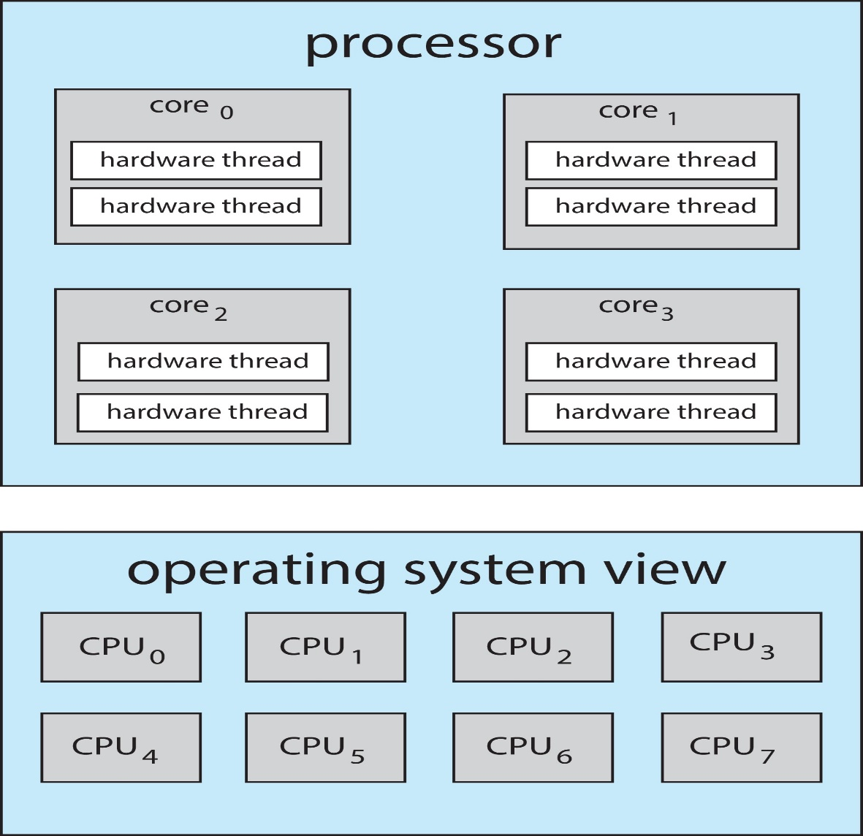
A Dual-Threaded, Quad-Core System
Thus, a dual-threaded, quad-core system => eight logical processor to the OS

Slide 74
If M-to-M or M-to-1 Model
Three levels of scheduling is used instead
Level 1: choose which user thread to run on each kernel thread
Done by thread library
Level 2: choose which kernel thread to run on each logical processor
Done by the OS
Uses the algorithms shown in Section 5.3
Level 3: specifies how each core decides which hardware thread to run
Done by the hardware
Example: UltraSPARC T3 uses round-robin to schedule

Slide 75
If One-to-One Model
Two levels of scheduling in a multithreaded multi-core processor
Level 1: choose which software thread (kernel thread) to run on each logical processor
Done by the OS
Level 2: specifies how each core decides which hardware thread to run
Done by the hardware

Slide 76
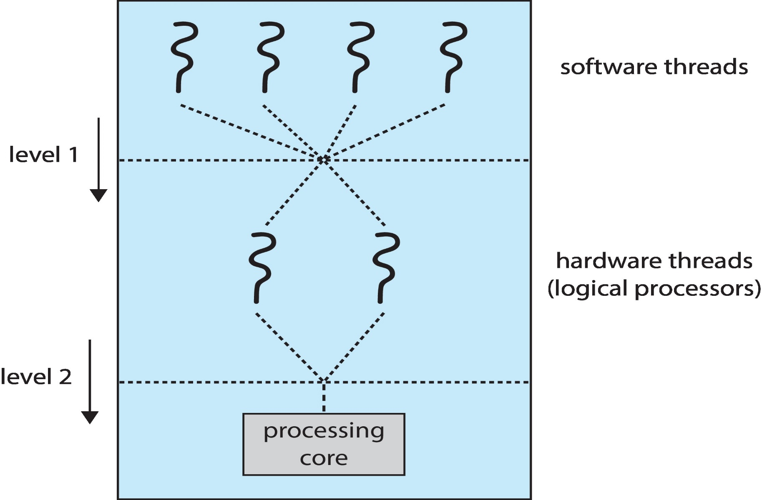
Two Levels of Scheduling

Slide 77
Outline
Basic Concepts
Scheduling Criteria
Scheduling Algorithms
Thread Scheduling
Multiple-Processor Scheduling
Approaches to Multiple-Processor Scheduling
Multicore Processors
Load Balancing
Processor Affinity
Heterogeneous Multiprocessing
Real-Time CPU Scheduling
Operating Systems Examples
Algorithm Evaluation

Slide 78
Load Balancing
Problem: see page 67
Keep the workload evenly distributed across all processors
See the following slides
Load balancing is done by process migration
Only necessary on private ready queue systems
In common-ready-Q systems, the load is already balanced

Slide 79
複習：Organizations of Ready Queue in SMP
All threads may be in a common ready queue,
Each processor may have its own private queue of threads

Slide 80
Outline
Basic Concepts
Scheduling Criteria
Scheduling Algorithms
Thread Scheduling
Multiple-Processor Scheduling
Approaches to Multiple-Processor Scheduling
Multicore Processors
Load Balancing
Processor Affinity
Heterogeneous Multiprocessing
Real-Time CPU Scheduling
Operating Systems Examples
Algorithm Evaluation

Slide 81
Processor Affinity (喜好）
When a process migrates to another processor
Old cache memory must be invalidated
New cache memory must be re-populated
Thus, most SMP systems avoid migration of process from one processor to another
Processor affinity: keep a process/thread running on the same processor
Per-processor ready queues: provide processor affinity for free!
A common ready queue: need special handling.

Slide 82
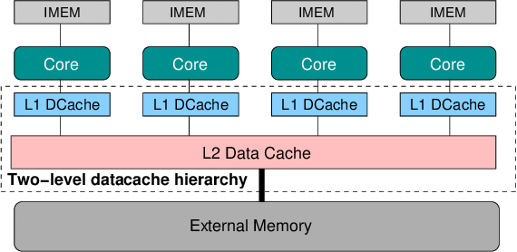
https://www.researchgate.net/figure/Two-level-Cache-Hierarchy-in-MPSoC-Architecture_fig1_262370152

Slide 83
Processor Affinity (喜好）(Cont.)
But loading balancing counteracts the benefits of processor affinity
Load balancing is done by process migration
Processor affinity try not to migrate processes

Slide 84
Outline
Basic Concepts
Scheduling Criteria
Scheduling Algorithms
Thread Scheduling
Multiple-Processor Scheduling
Approaches to Multiple-Processor Scheduling
Multicore Processors
Load Balancing
Processor Affinity
Heterogeneous Multiprocessing
Real-Time CPU Scheduling
Operating Systems Examples
Algorithm Evaluation

Slide 85
Heterogeneous Multiprocessing
The above four issues assume homogeneous multi-processors
Heterogeneous Multiprocessing (HMP)
Some systems are designed using cores that run the same instruction set, yet vary their clock speed and power management
Especially for mobile devices
Example: ARM big.L ITTLE architecture
High performance big cores combined with energy efficient LITTLE cores

Slide 86
Heterogeneous Multiprocessing
Advantages
CPU scheduler
Assign tasks that do not require high performance, but need to run for longer periods to little cores
E.g., background tasks
Assign interactive tasks to big cores
Need higher performance and run for shorter durations
Power management
If in power-saving mode, big cores can be disabled and the system rely only on LITTLE cores

Slide 87
Outline
Basic Concepts
Scheduling Criteria
Scheduling Algorithms
Thread Scheduling
Multiple-Processor Scheduling
Real-Time CPU Scheduling (Skip!)
Operating Systems Examples
Algorithm Evaluation

Slide 88
Outline
Basic Concepts
Scheduling Criteria
Scheduling Algorithms
Thread Scheduling
Multiple-Processor Scheduling
Real-Time CPU Scheduling
Operating Systems Examples (Skip!)
Algorithm Evaluation

Slide 89
Linux Scheduling
Preemptive, priority-based scheduling with two priority ranges
Real-time: 0~99
Nice (for time-sharing): 100~140
Time-sharing: dynamic priority-based
Priority is changed depends on task’s interactivity
Priority boosts for interactive or IO bound processes
Real-time: static priority-based
Soft real-time
FCFS and RR
Highest priority process always runs first

Slide 90
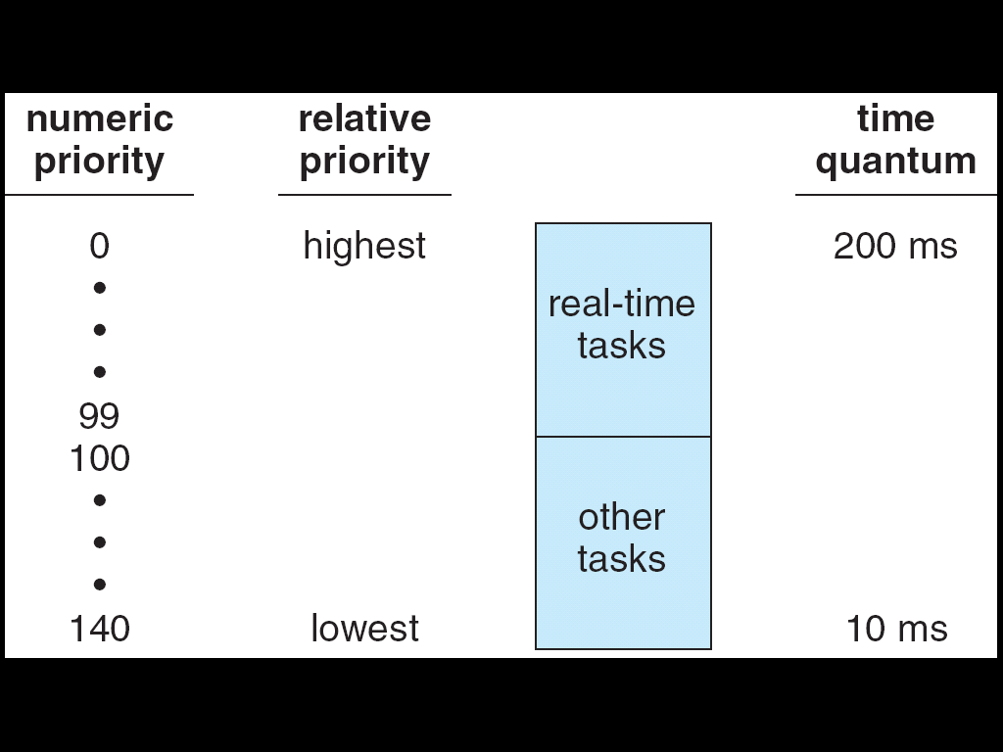
The Relationship Between Priorities and Time-slice length
higher priority=>longer time quantum

Slide 91
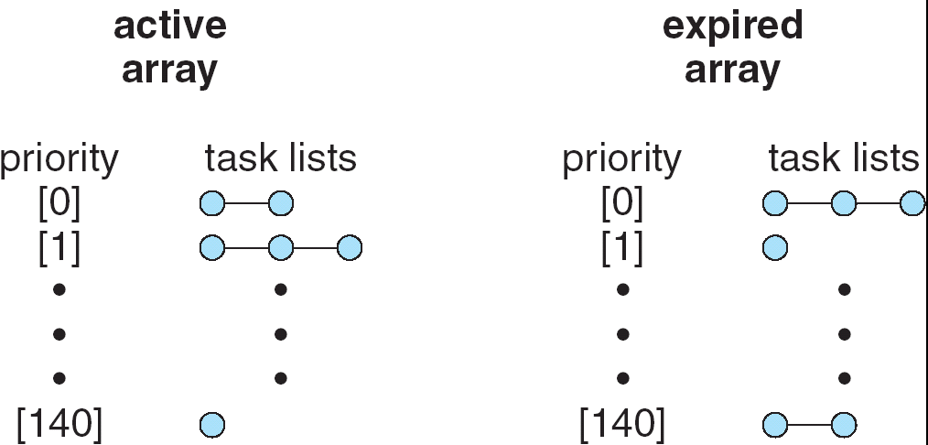
List of Tasks Indexed According to Priorities
Each ready Q contains two arrays: active and expired
When active array becomes empty=> switch

Slide 92
Outline
Basic Concepts
Scheduling Criteria
Scheduling Algorithms
Thread Scheduling
Multiple-Processor Scheduling
Real-Time CPU Scheduling
Operating Systems Examples
Algorithm Evaluation (Skip!)
Deterministic Modeling
Queuing Models
Simulations
Implementation

Slide 93
Algorithm Evaluation
Evaluation methods
Deterministic modeling
Queuing models
Simulations
Implementation

Slide 94
Algorithm Evaluation
Evaluation methods
Deterministic modeling
Queuing models
Simulations
Implementation

Slide 95
Deterministic Modeling
Analytic evaluation –
(algorithm) + (workload) = (number or formula)
This number is used to evaluate the performance of the algorithm for that workload
Deterministic modeling is one type of analytic evaluation
Deterministic modeling –
No randomness is involved in the system
Takes a predetermined workload and defines the performance of each algorithm for that workload
Good: simple, fast, and give exact numbers
Bad: require exact numbers for input, and answers apply only to the input
Thus, it is useful only when the set of programs and their behaviors are fixed

Slide 96
Example of Deterministic Modeling
Example:
CPU burst time: P1 = 10, P2 = 29, P3 = 3, P4 = 7, P5 = 12
Algorithm evaluations
If FCFS, average waiting time = 28
If nonpreemptive SJF, average waiting time = 13
If RR, average waiting time = 23
In this case, nonpreemptive SJF is the best
Similar to what we have done in this Chapter

Slide 97
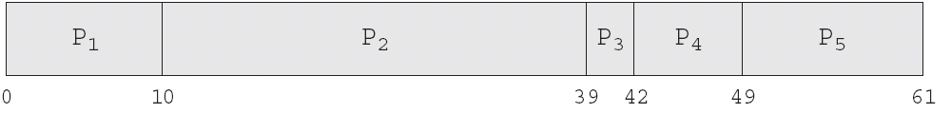
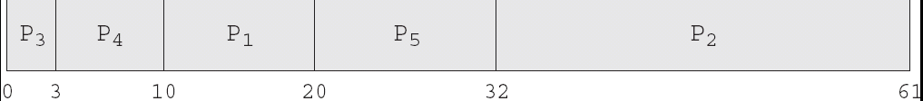

Gantt Chart
FCFS
Nonpreemptive SJF
RR

Slide 98
Algorithm Evaluation
Evaluation methods
Deterministic modeling
Queuing models
Simulations
Implementation

Slide 99
Queuing Models
Input:
Distribution of CPU and I/O bursts
Distribution of process arrival time
Output: the average throughput, utilization, waiting time…
Mathematical and statistical analysis
Approximation of a real system – thus, accuracy may be questionable

Slide 100
Algorithm Evaluation
Evaluation methods
Deterministic modeling
Queuing models
Simulations
Implementation

Slide 101
Simulations
Programming a model of the computer system
Use software data structure to model queues, CPU, devices, timers…
Disadvantage – expensive

Slide 102
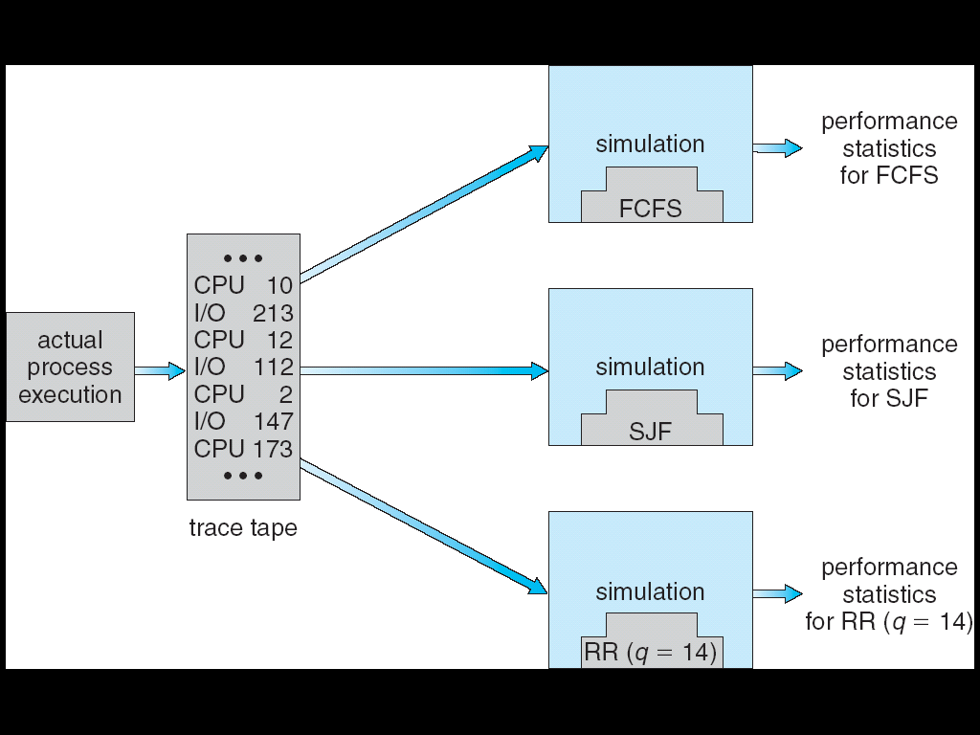
Evaluation of CPU Scheduler by Simulation

Slide 103
Algorithm Evaluation
Evaluation methods
Deterministic modeling
Queuing models
Simulations
Implementation

Slide 104
Implementation
Code a scheduling algorithm, put it in OS, and see…
Good: the most convinced approach
Difficulty
High cost
Coding the algorithm and modifying the OS

Slide 105
期中考
範圍：Chapter 1~5
Date: 4/11, 9:10~12:00
Closed book

